Slide 1

Automation of Invoice Reporting with UiPath
Annette Partida
AI Automation | Project 6

Slide 2
Problem
A finance team receives multiple supplier invoices each week and currently processes them manually by opening each document, extracting key details, and summarizing purchases.
This approach is time-consuming, prone to errors, and makes it difficult to quickly identify which invoices are due by specific dates.

Slide 3
Solution
The goal is to automate invoice processing (RPA) by reading files from Google Drive, extracting key fields, generating short purchase descriptions with AI, and writing results into Google Sheets. The workflow also flags low-confidence data for manual review, ensuring accuracy while saving time.

Slide 4
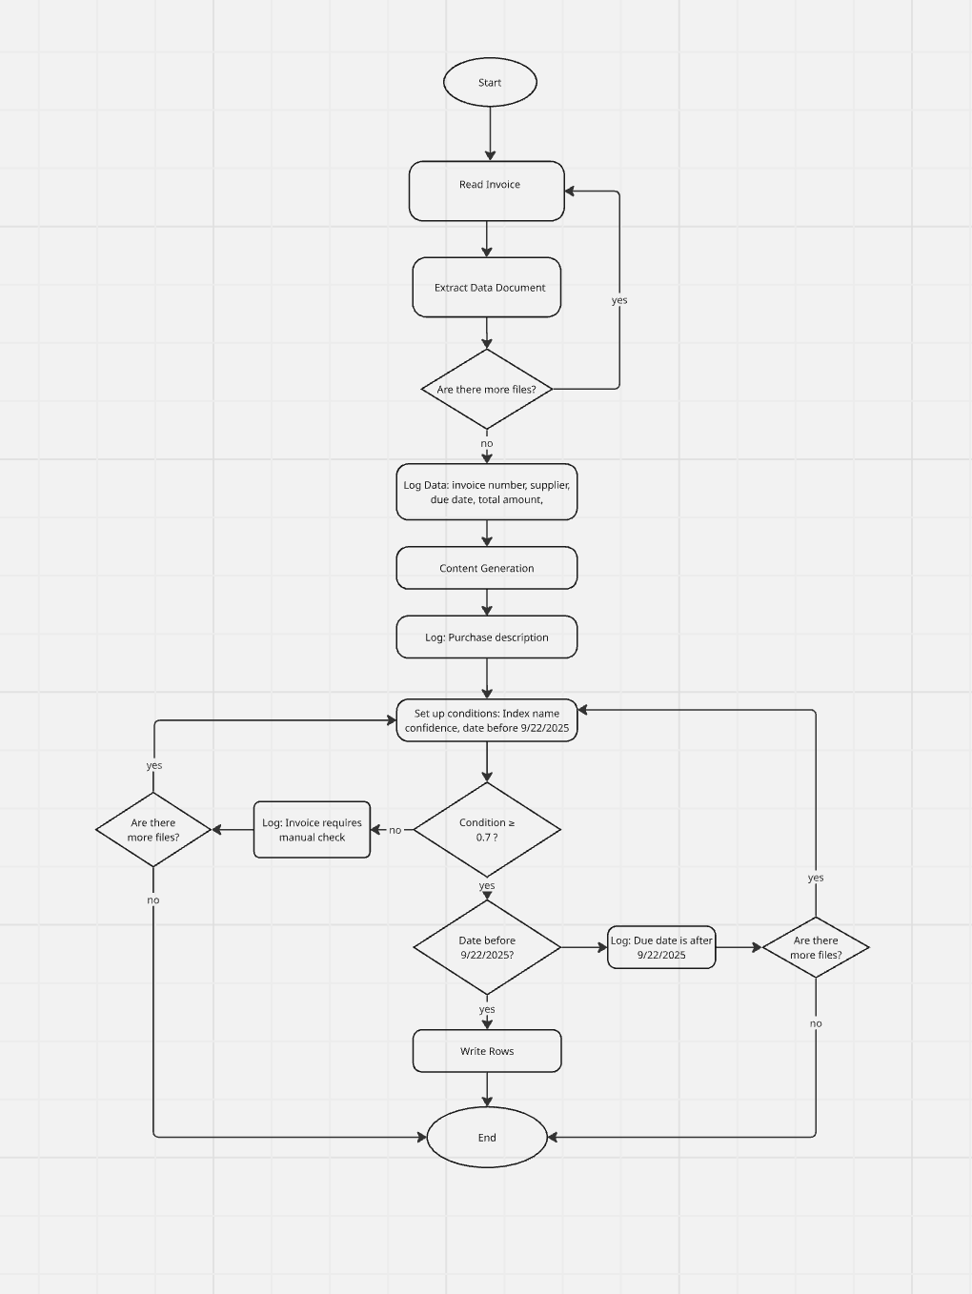
RPA workflow diagram

Slide 5
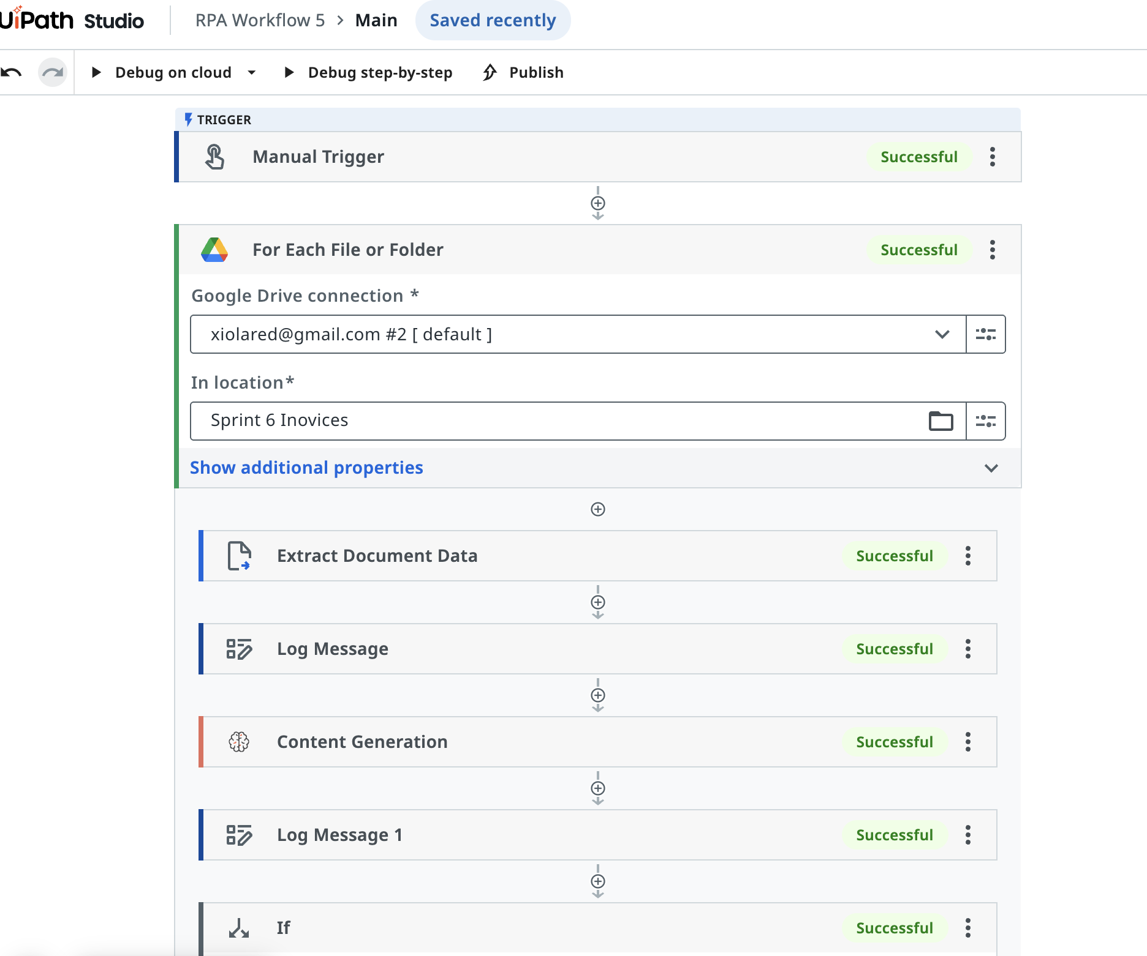
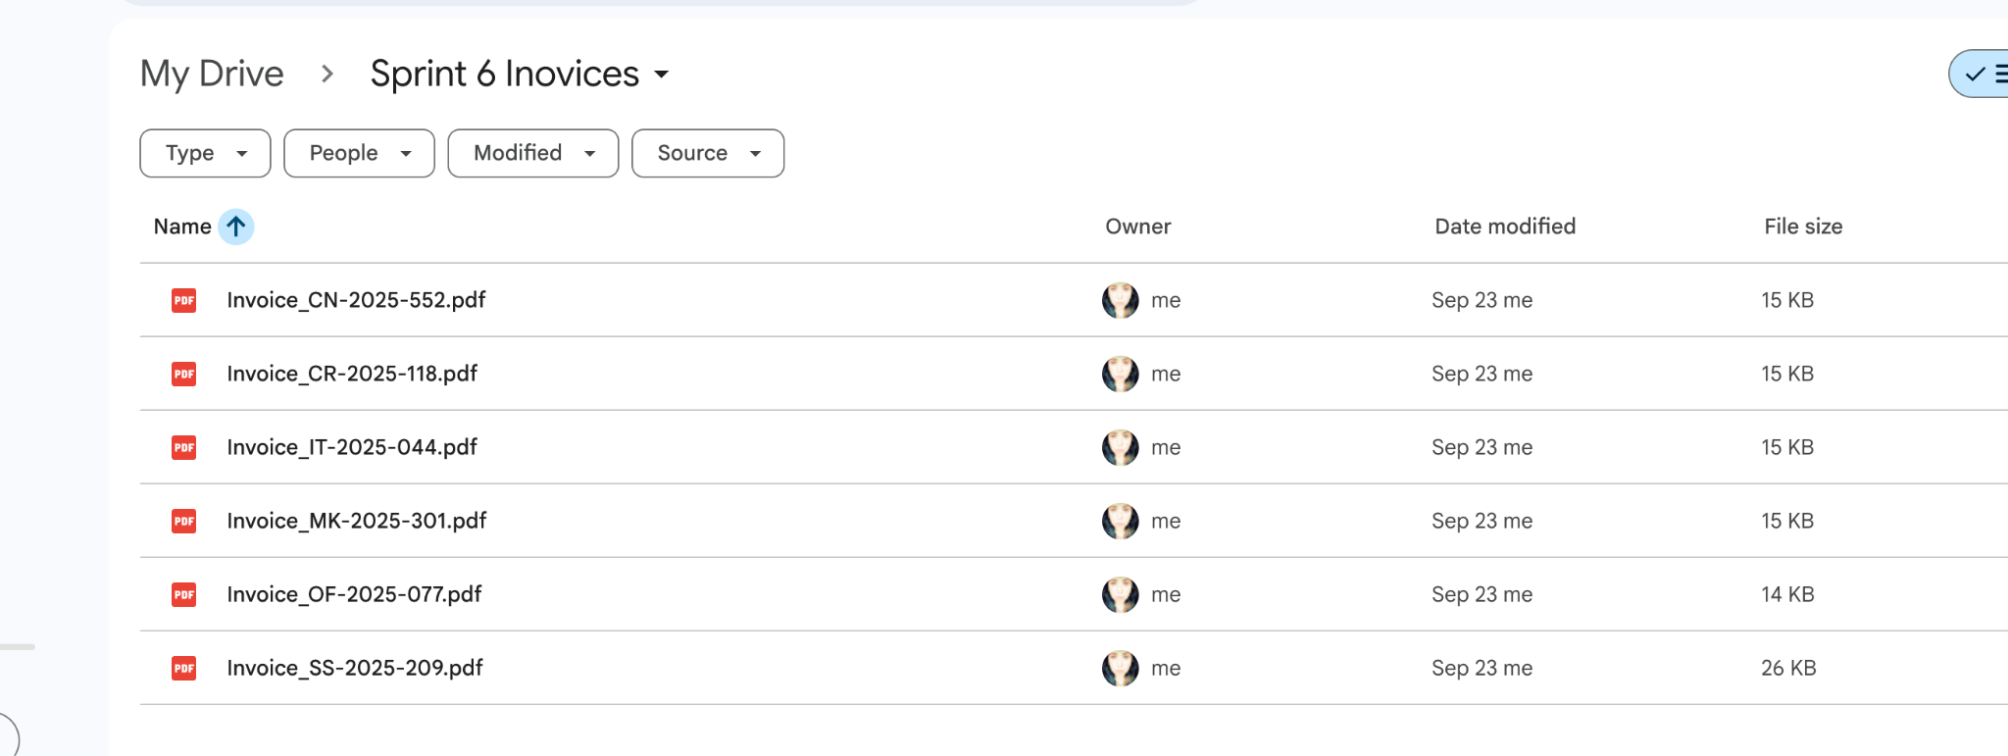
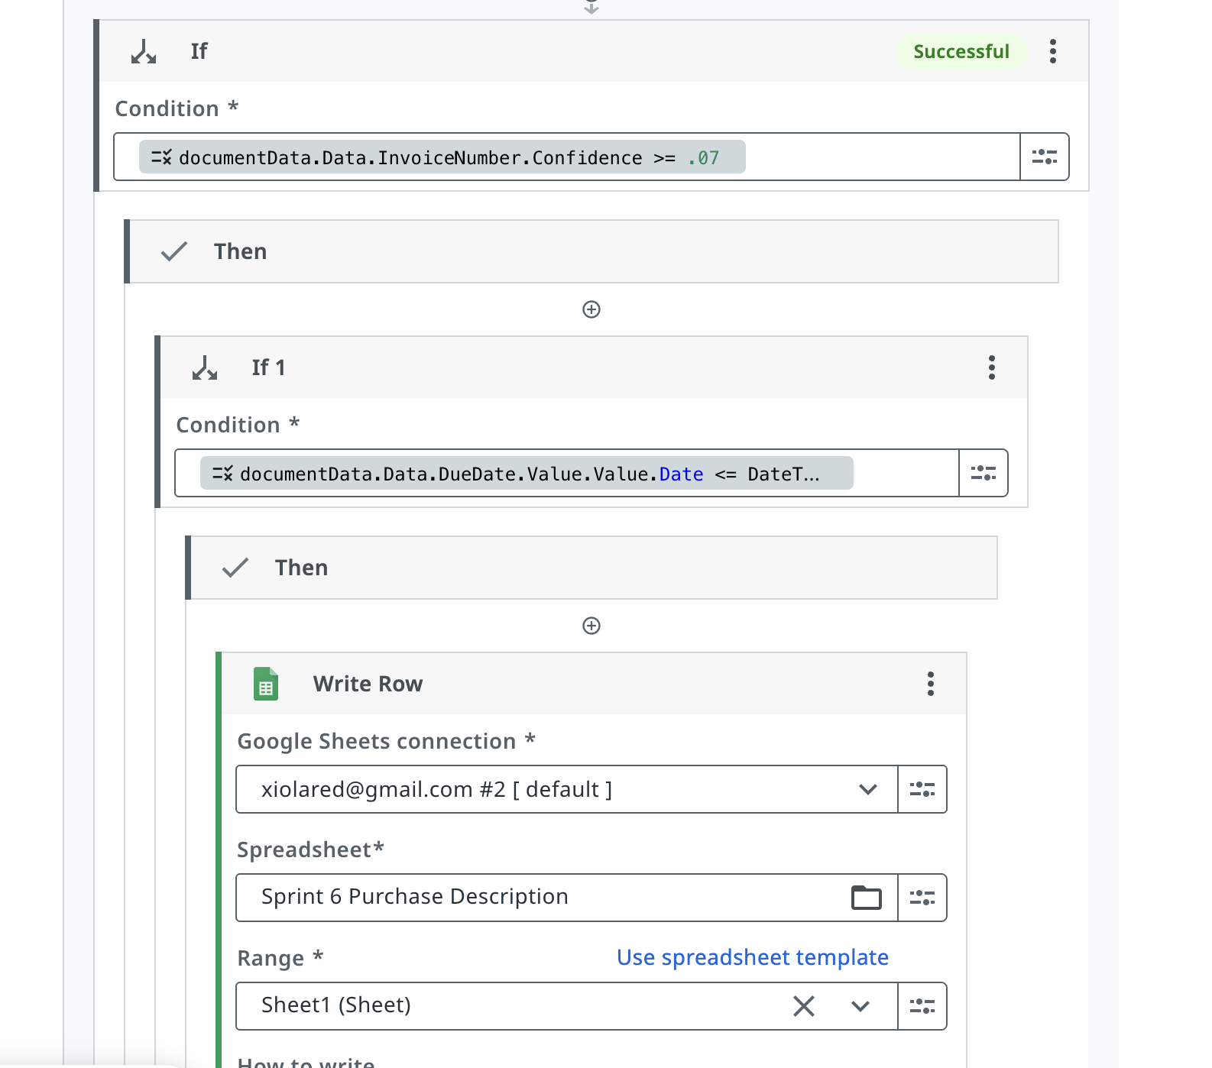
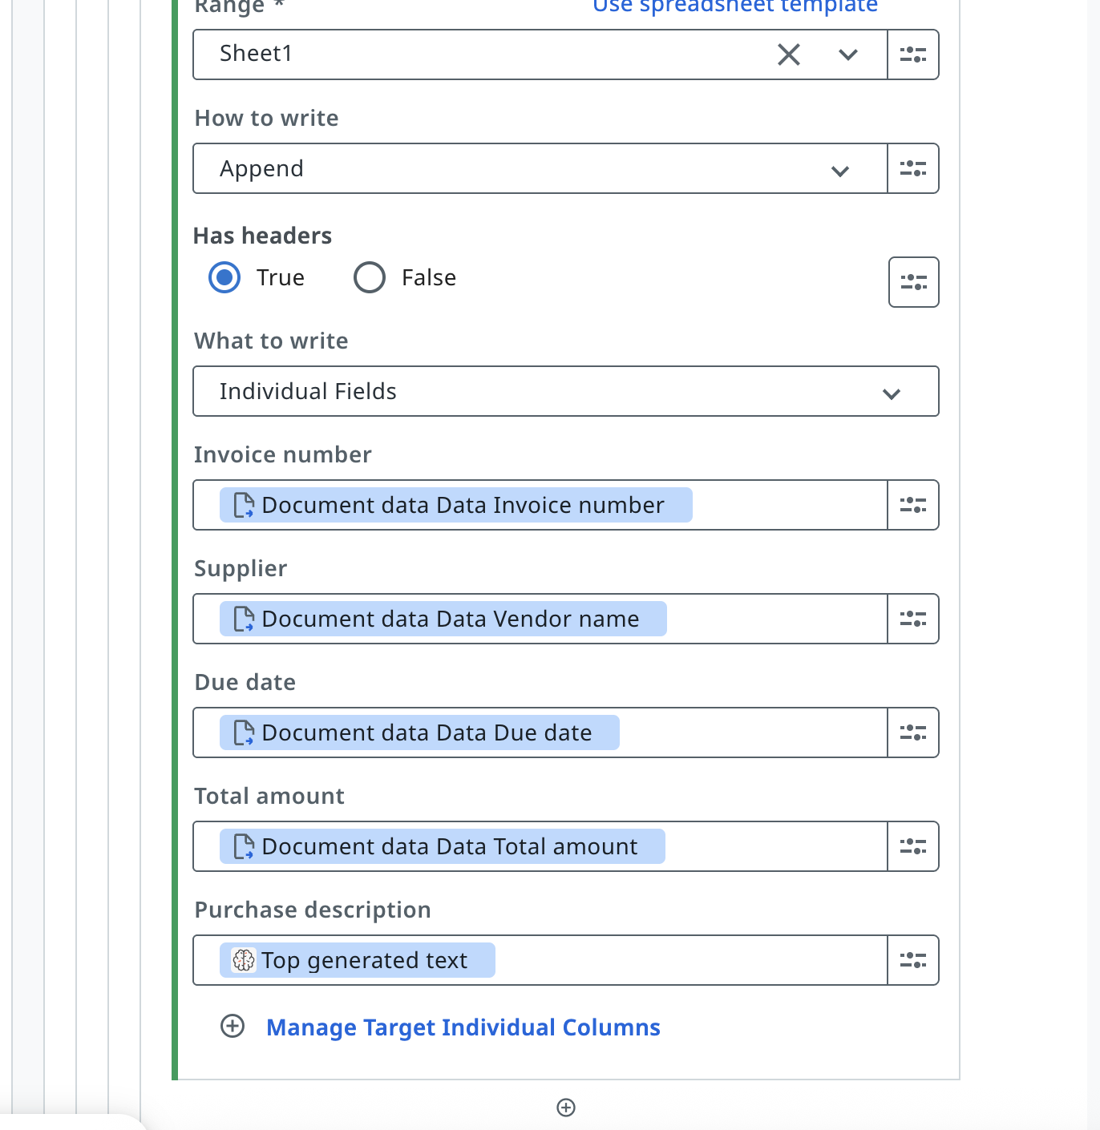
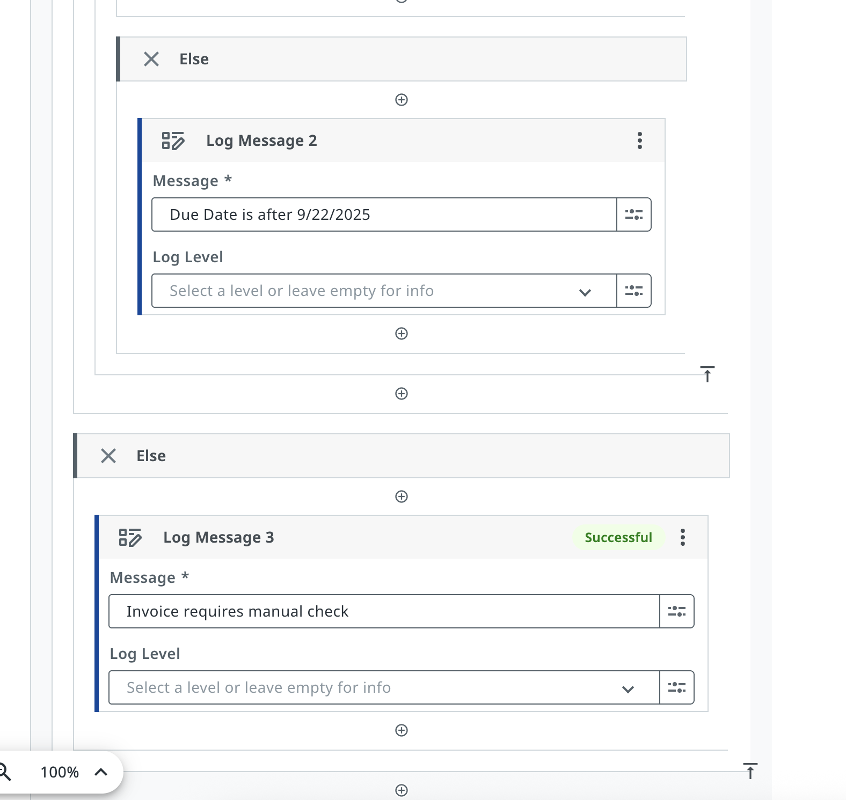

Slide 6
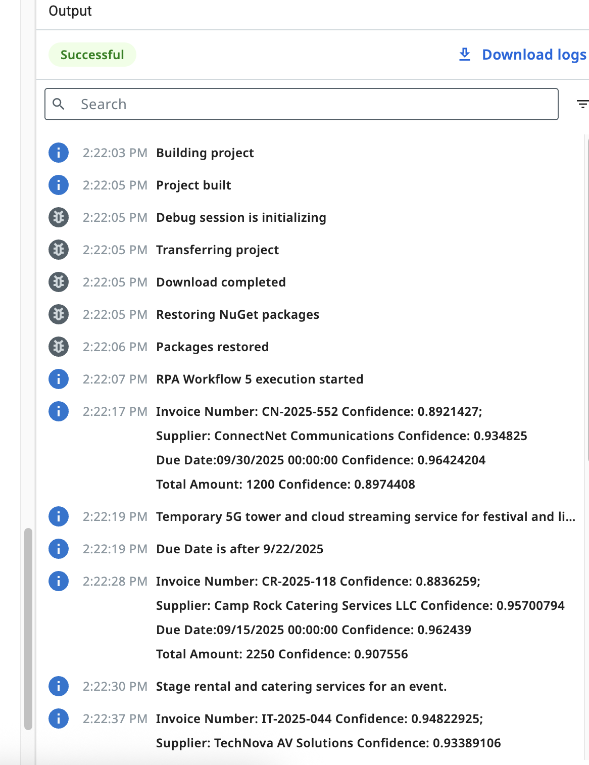
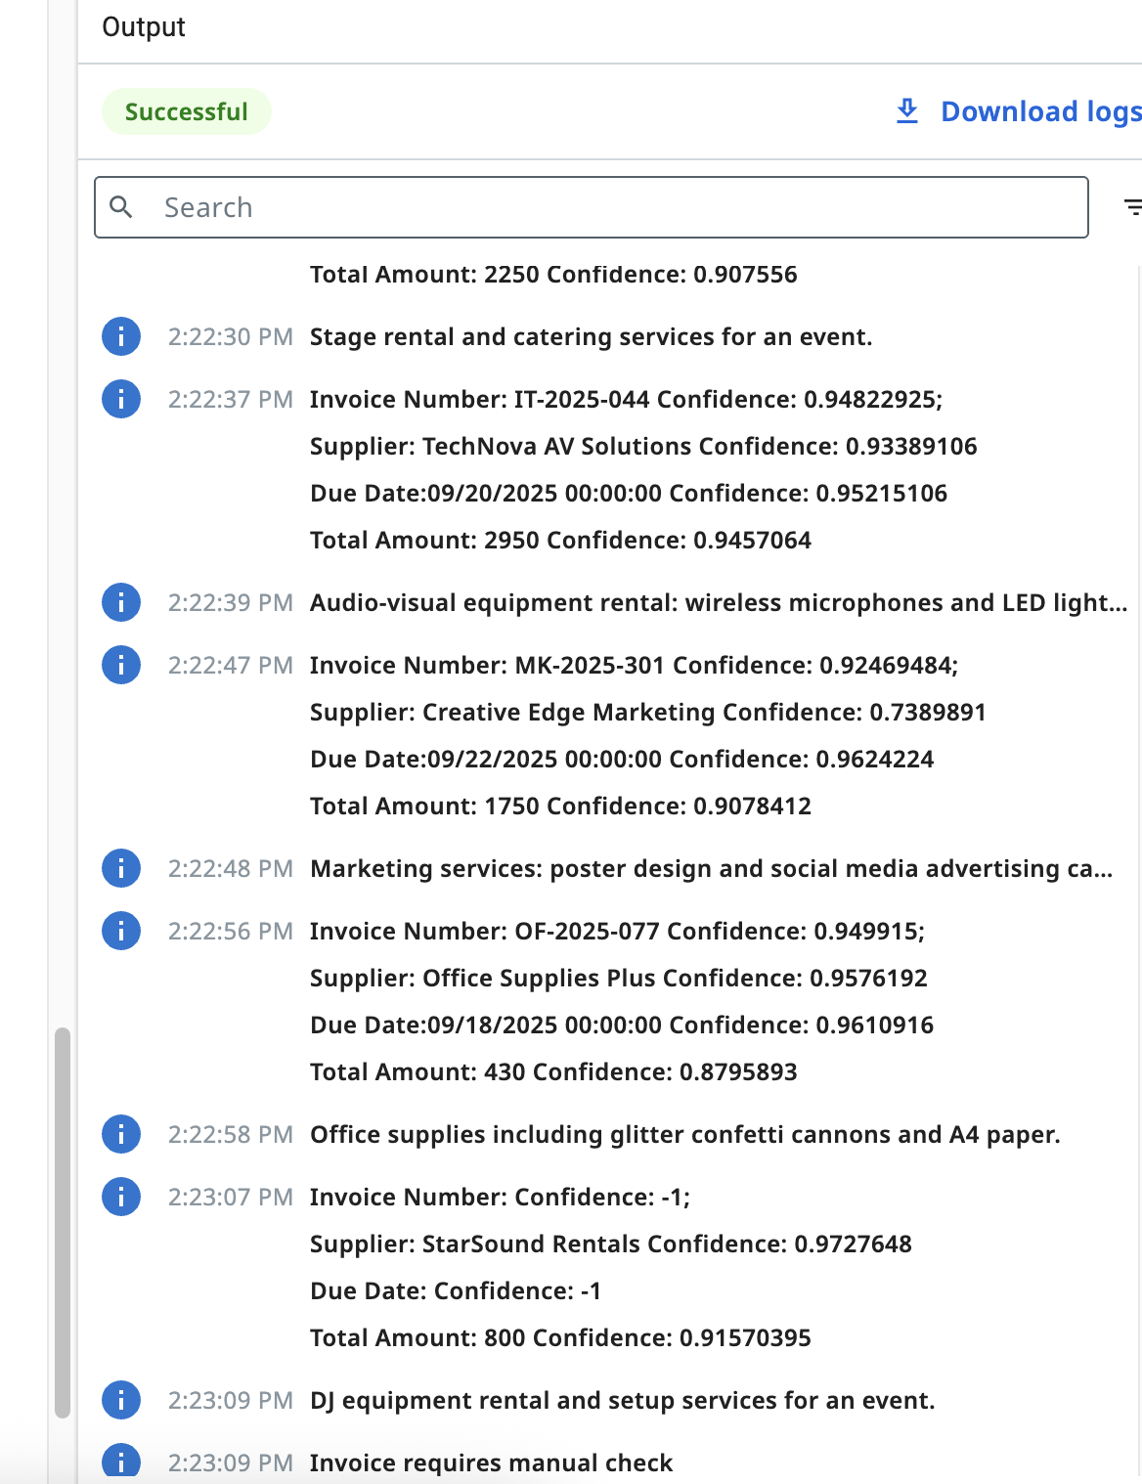

Slide 7
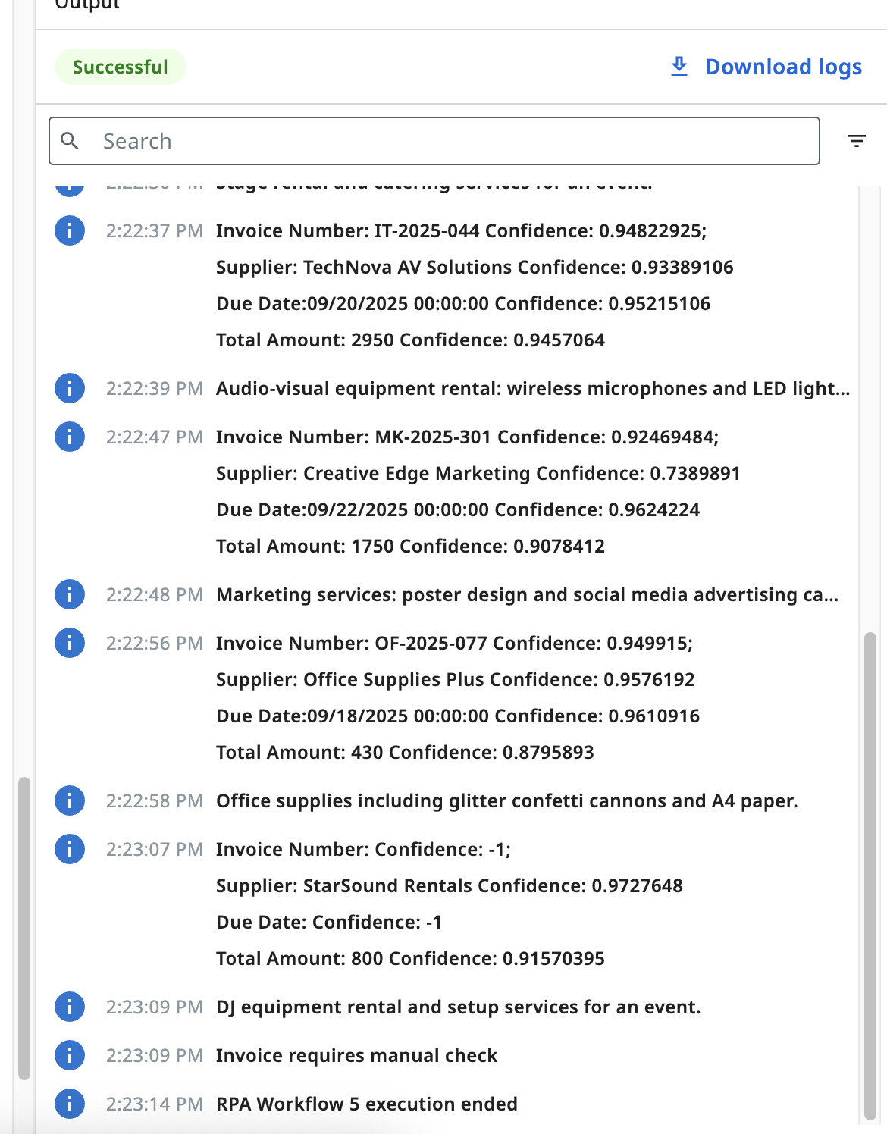
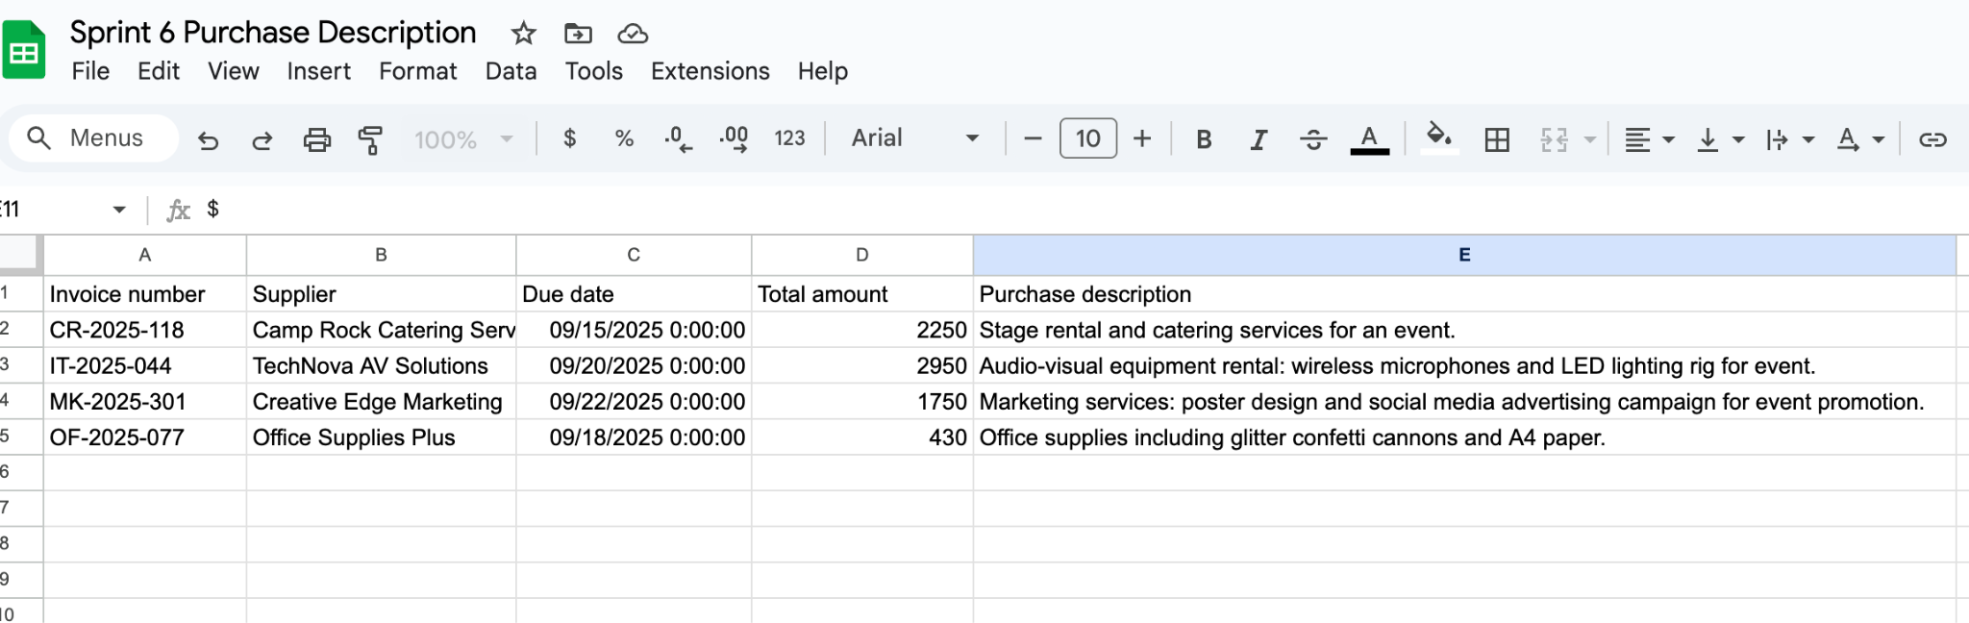
These were screenshots taken during the course of building the automation:
-Invoices -RPA data boxes -Logs
-Purchase description Google Sheet

Slide 8
Benefits
Saves time by eliminating manual invoice reading and data entry.
Reduces errors through automated extraction and confidence checks.
Improves visibility with a structured Google Sheet showing all key invoice fields.
Adds context via AI-generated purchase descriptions for quick understanding.
Supports compliance by flagging low-confidence totals for manual review.
Scales easily to handle larger volumes of invoices as the company grows.

Slide 9
Challenges & improvements
Things I Learned
How to build a logical workflow in UiPath and understand the basics of robotic process automation.
The difference between RPA automations and AI automations, and imagining how combining them could create powerful, futuristic workflows.
The value of diagramming workflows in Miro — it helps visualize logic, improve efficiency, and pinpoint where flaws may occur.
By following one of Steve’s diagrams, I leveled up my own approach to designing process diagrams.

Slide 10
Challenges & improvements
Challenges I Faced
Learning how to configure and get data boxes to run properly in UiPath.
Ambiguity in some of the sprint instructions, especially with instruction for the small bottom button(+) for adding conditions or actions in the same data box.
No clear guidance on how to set up the date function in the workflow.

Slide 11
Challenges & improvements
Improvements I Suggested
Clearer instructions and examples in the sprint materials, especially for bottom button(+) and date setup.
Continue providing tutor support, as it was very helpful when I got stuck.
Encourage more use of workflow diagrams early on, since they make troubleshooting easier and reinforce logical thinking.

